Slide 1


Advanced Applications of Systems Modeling &Simulation
Dr. Xueping Li
University of Tennessee, Knoxville

Slide 2
Case Study: Ophthalmology Department Model

Slide 3
Business Logic
In this section of the tutorial we will build a model of a typical ophthalmology unit. Patients arrive to the department to undergo the ophthalmoscopy procedure. They are held in the waiting room and wait for ophthalmologists to come and make an examination. The procedure is held in the procedure room. When a doctor arrives, patient moves to empty procedure room escorted by the doctor. The procedure is performed using an ophthalmoscope. Ophthalmoscopes are stored in the storage room and are taken by doctors just before the procedure begins. Following the procedure, the doctor transports the ophthalmoscope back to the storage room and returns to the staffroom, and the patient leaves the ophthalmology department.

Slide 4
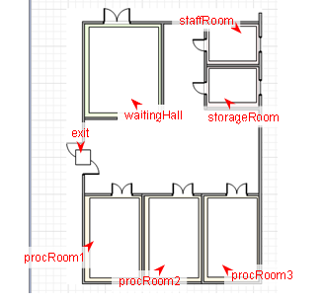

Slide 5
What’s needed
Modules
Move To
Size
Resource Attach
Release
Resource Pool
Resource Task Start/End

Slide 6
New concepts/modules
Parameter
Controls
Button
Slider
…

Slide 7
Phase 1 Tasks
Build the model
Define “agents”
Business logic -> models

Slide 8
Phase 2 Tasks
Enhance Animation
Walls
Floor plans
…

Slide 9
Debugging & troubleshooting
Step runs
Dive into Java?
…

Slide 10
Screenshots

Slide 11
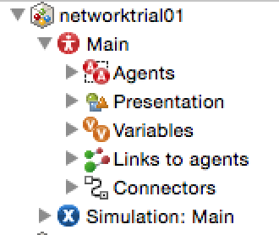
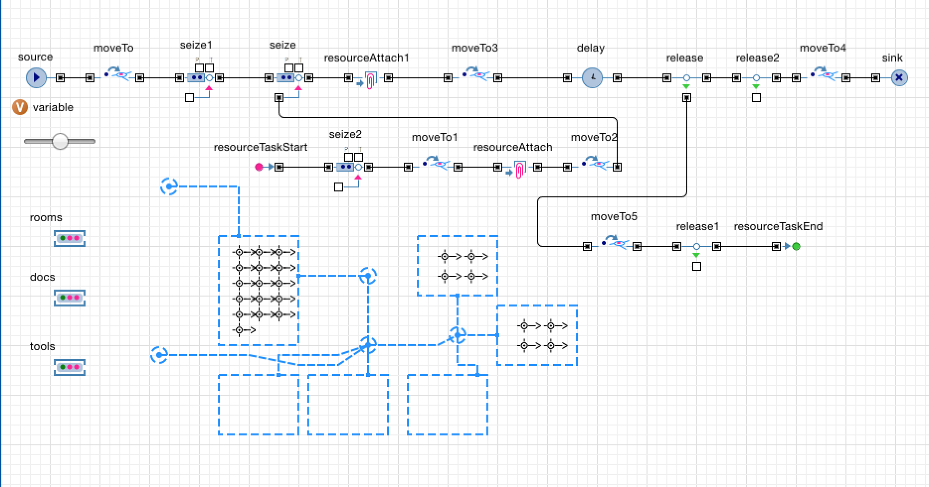

Slide 12
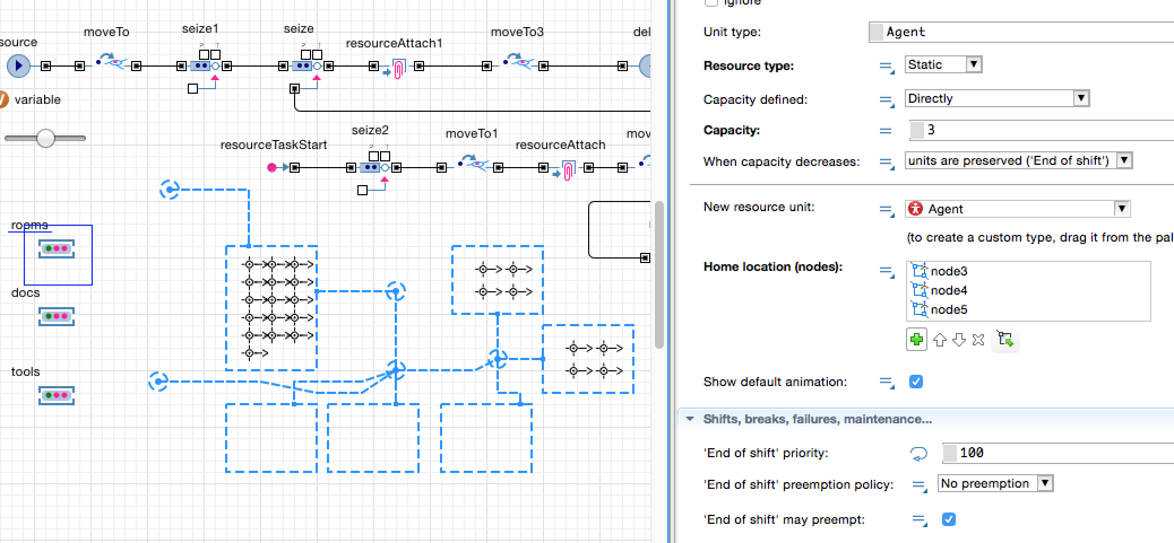

Slide 13
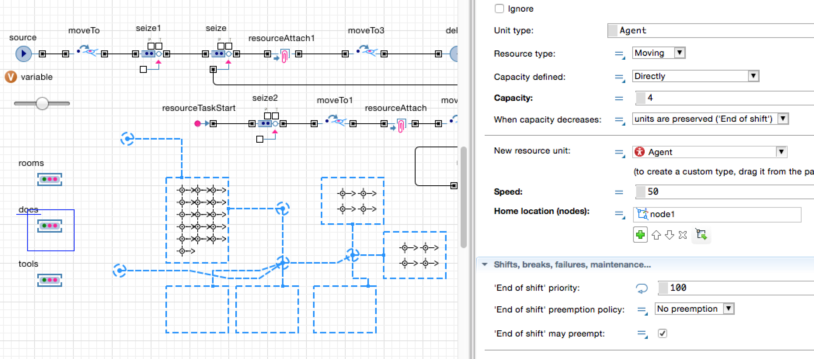

Slide 14
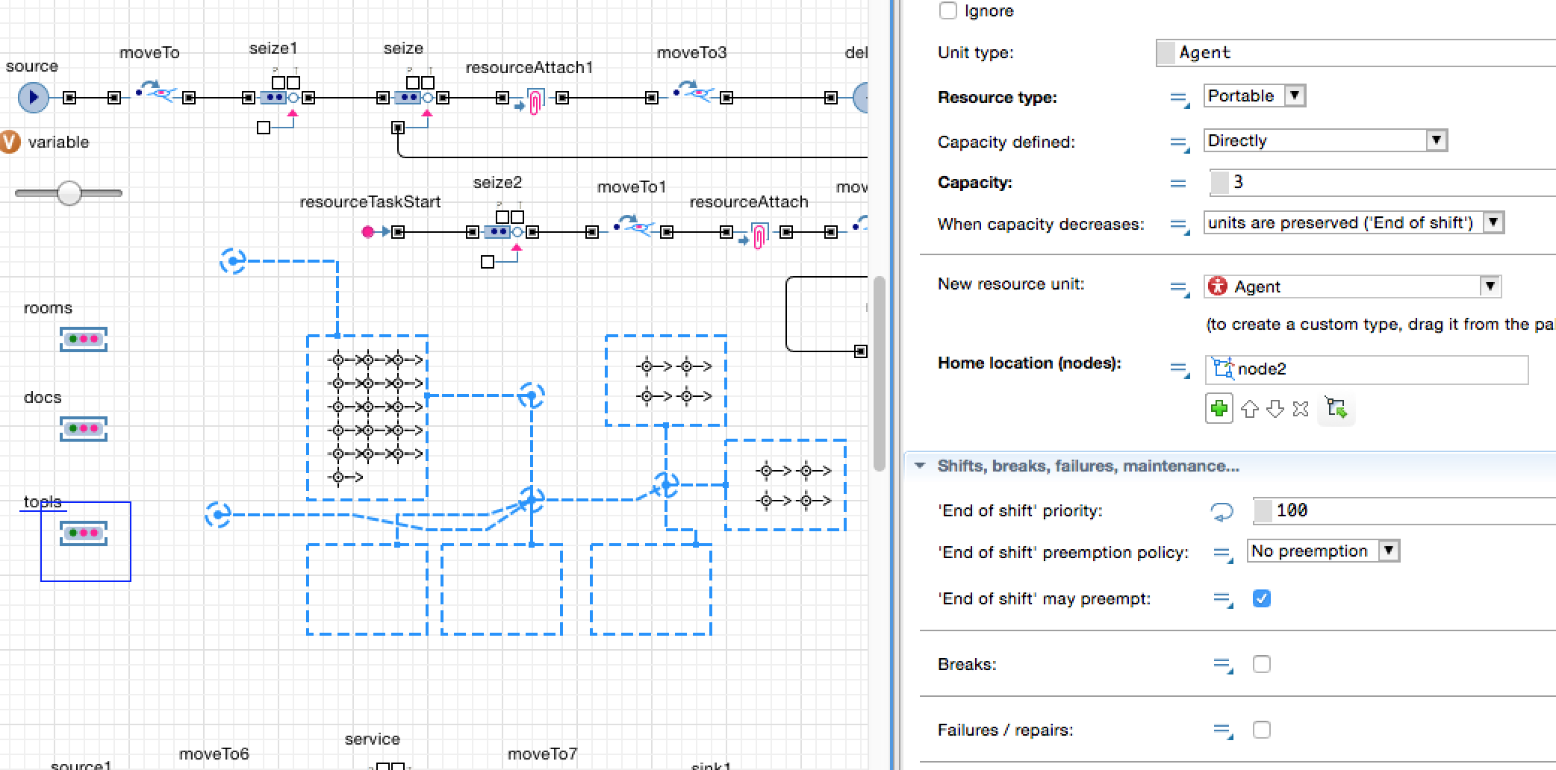

Slide 15
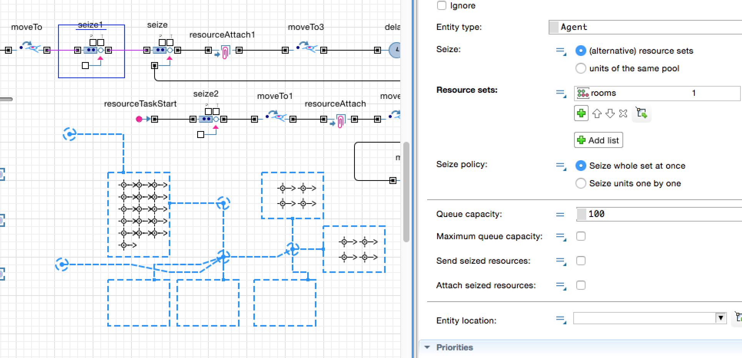

Slide 16
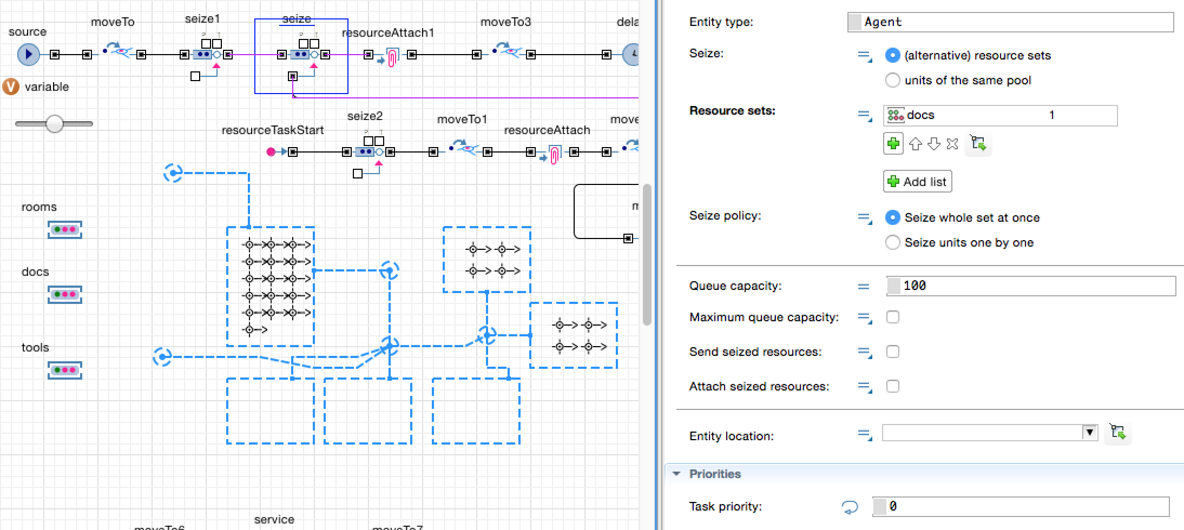

Slide 17
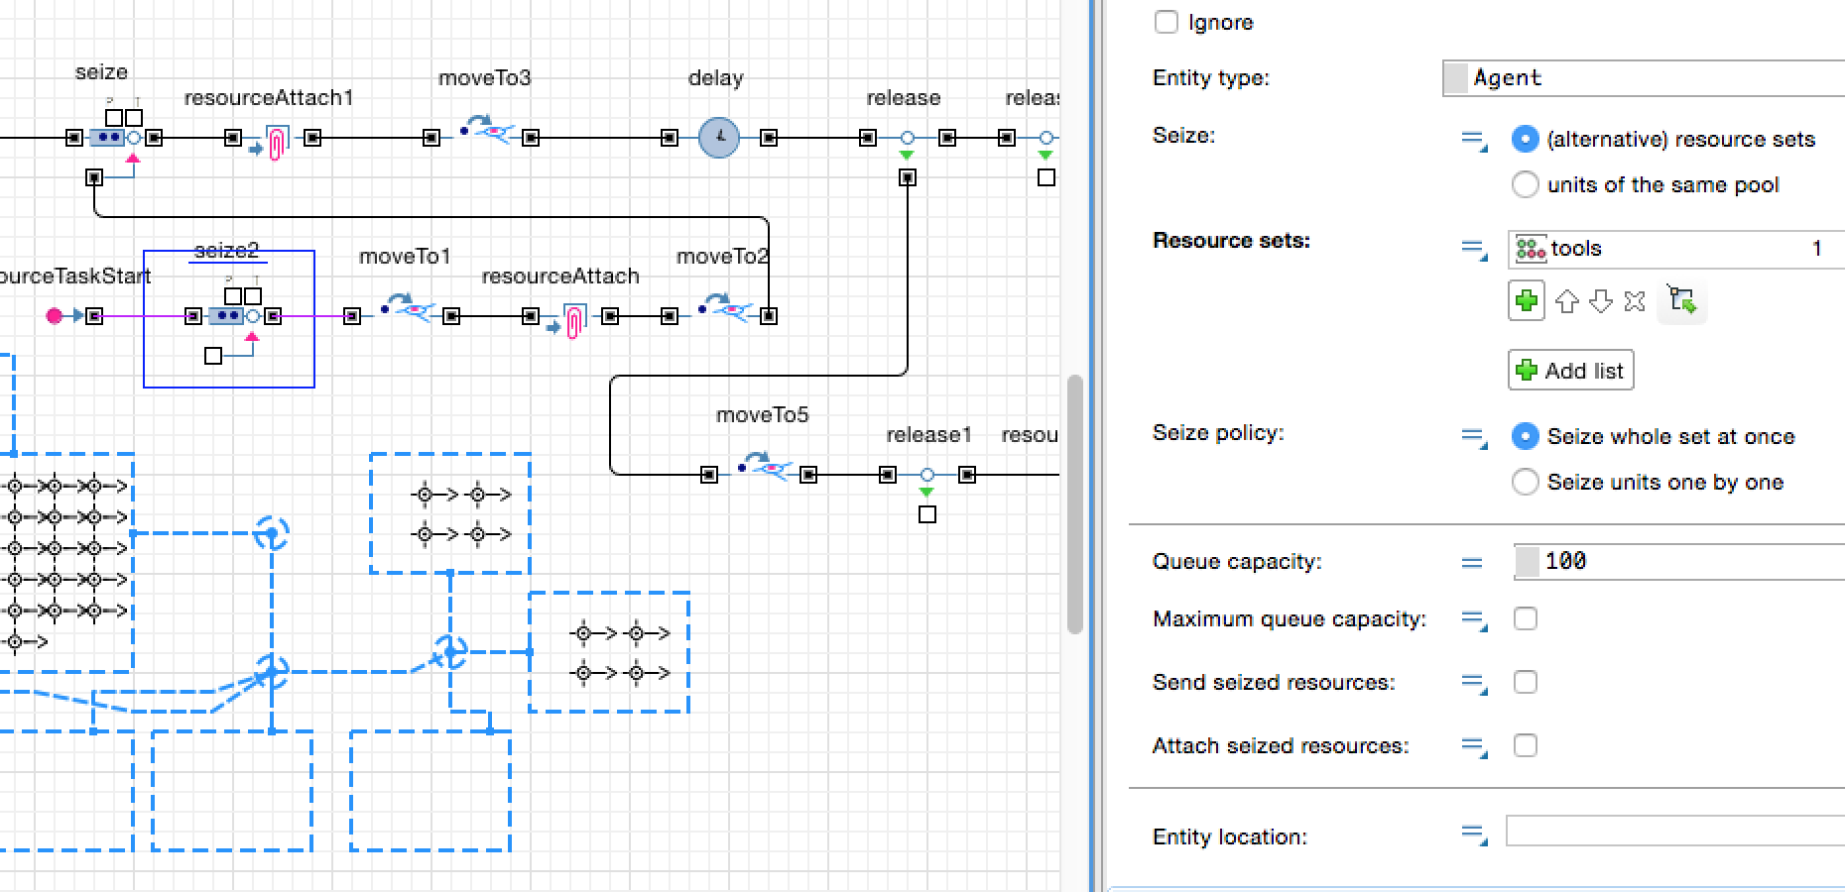

Slide 18
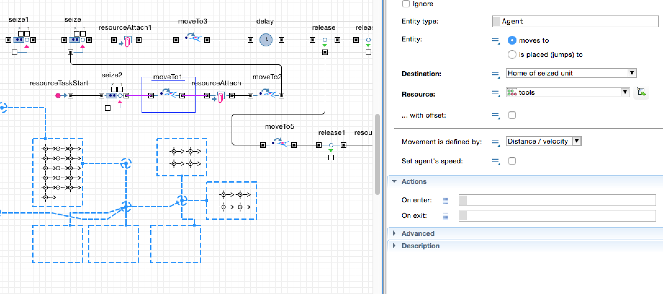

Slide 19
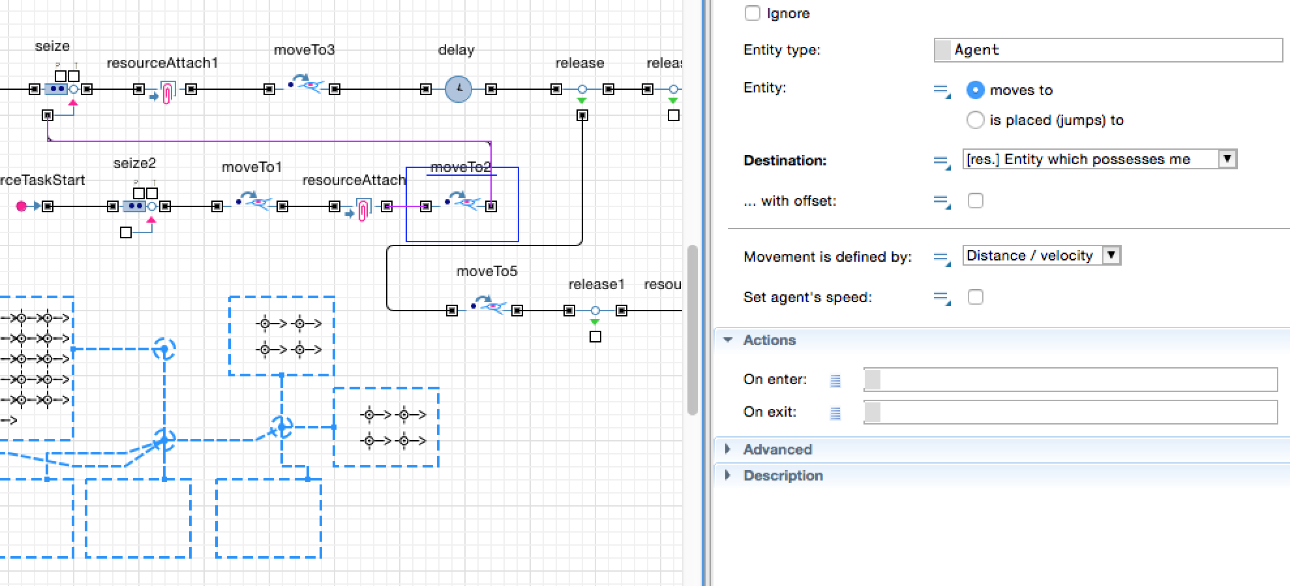

Slide 20
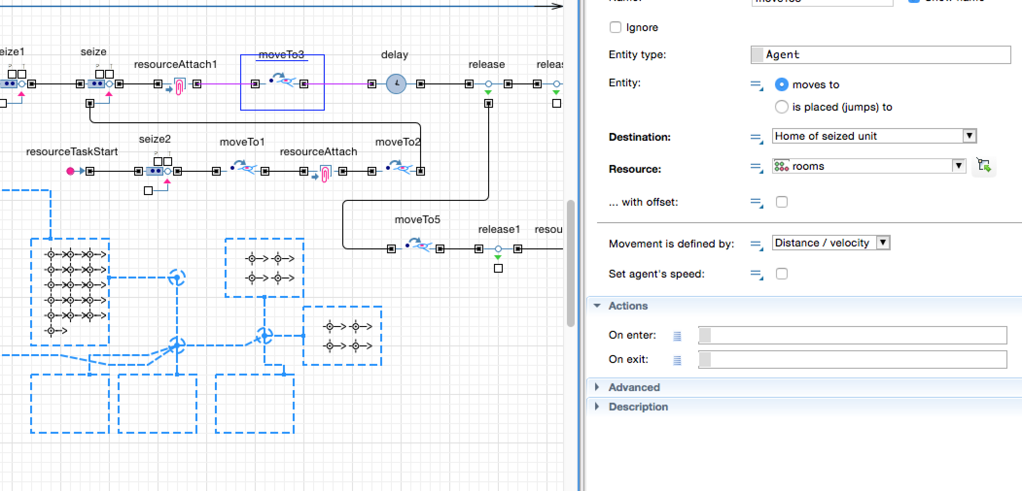

Slide 21
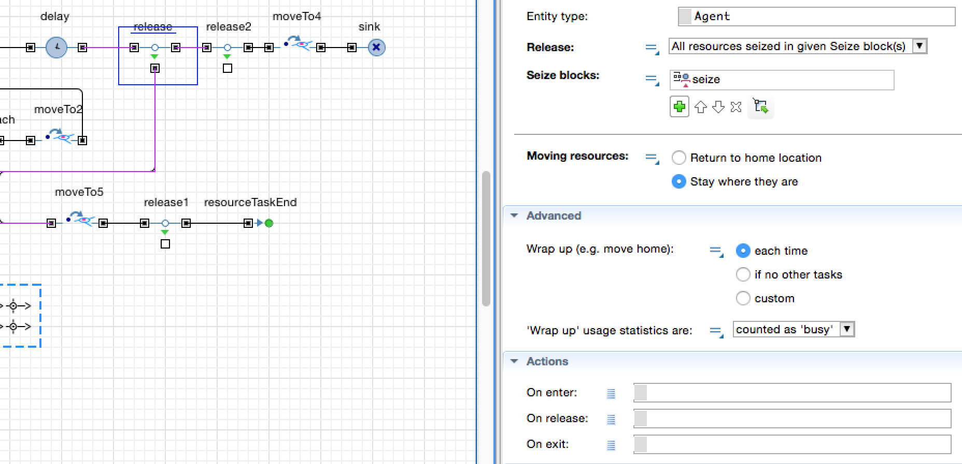

Slide 22
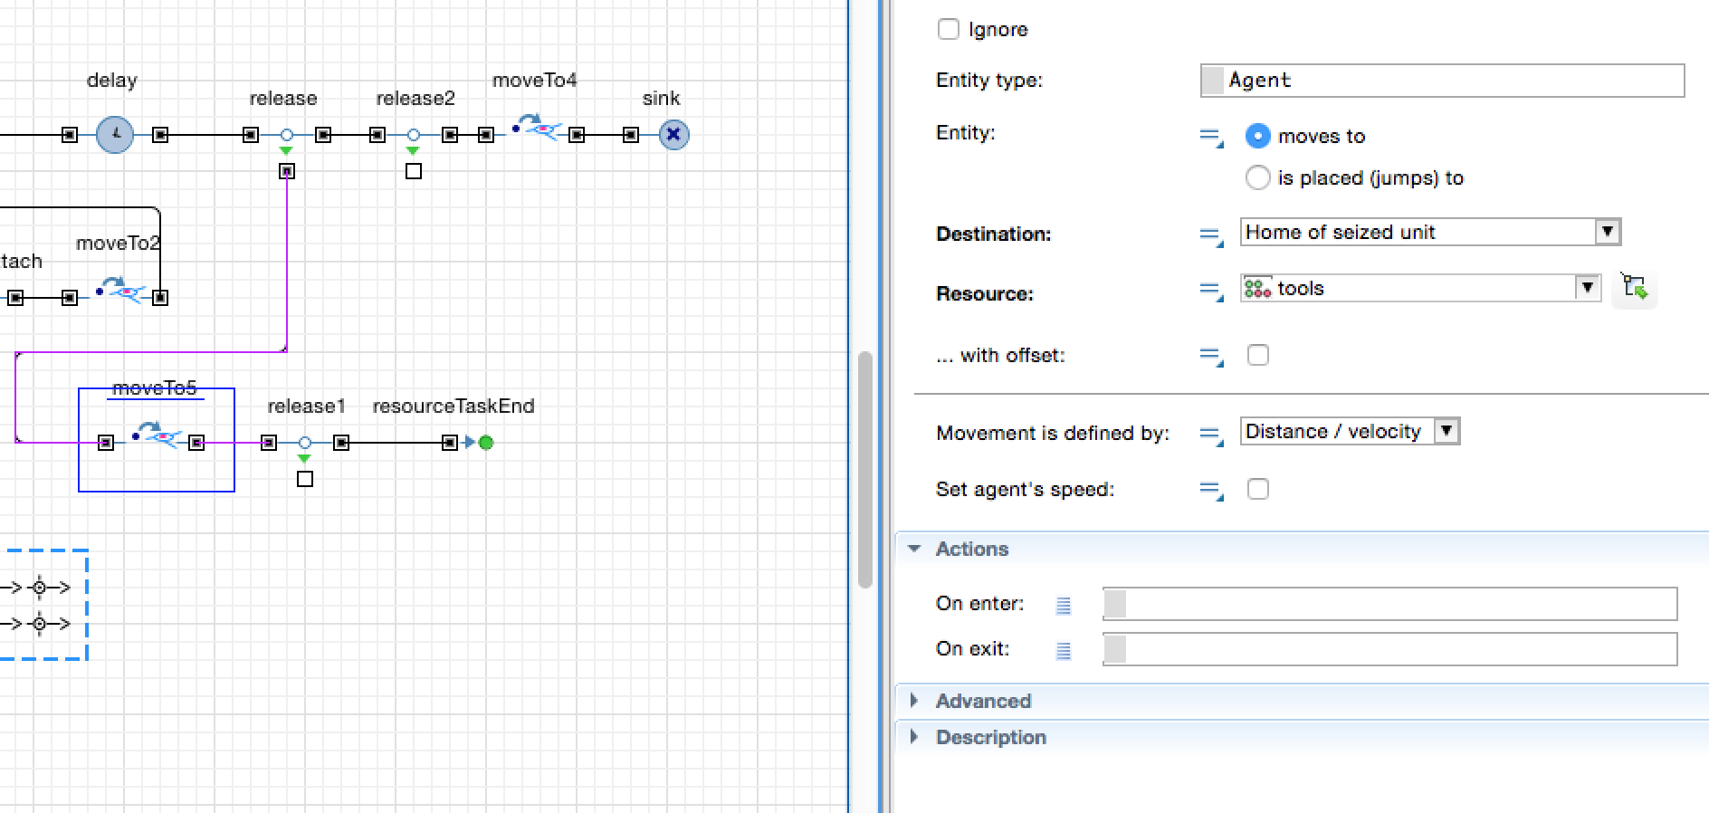

Slide 23
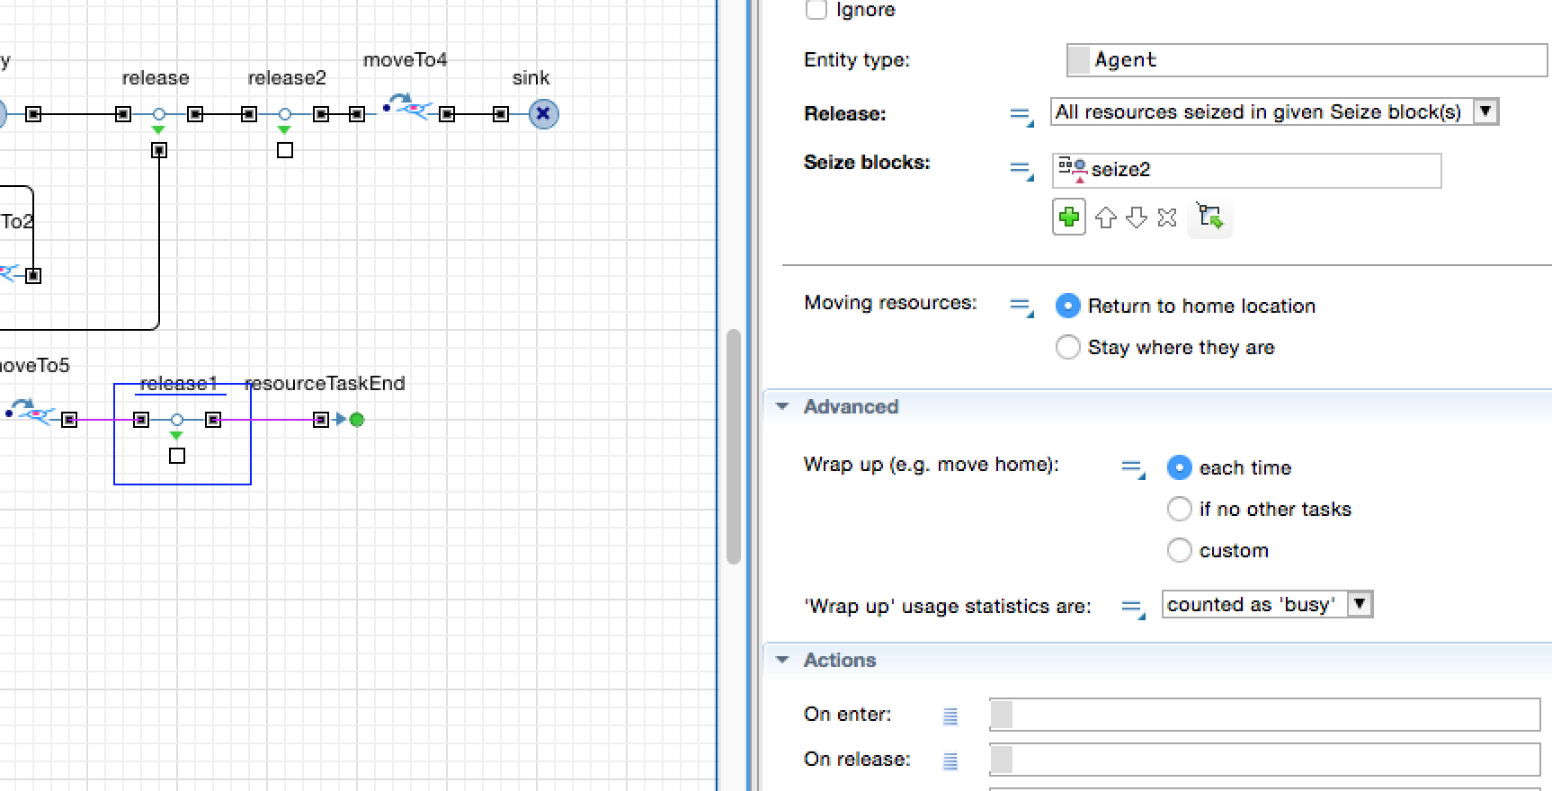

Slide 24
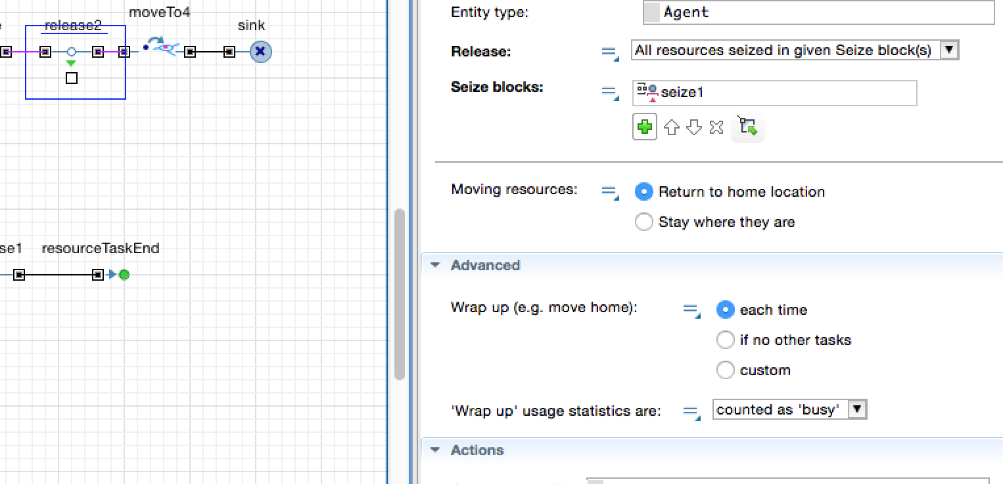

Slide 26
